Slide 1
Wildfire Analysis and Management
Sai Swaroop Tunuguntla (811300334)
Manuteja Medarametla (811286643)
Homeswar Rao Nelakurthi (811285989)
Group Number : 2

Slide 2
Introduction
Wildfires in California are becoming more frequent and several in wildfires, and their impact on the environment and human life is devastating.
To address this critical environmental concern, we have selected the WildFire documentation dataset from Kaggle as our primary source for studying the consequences of wildfires.
Our research goal is to explore the link between wildfires and air quality, identifying the quick and long-term impacts of particulate articles and other pollutants upon their dispersion before and during such events.

Slide 3
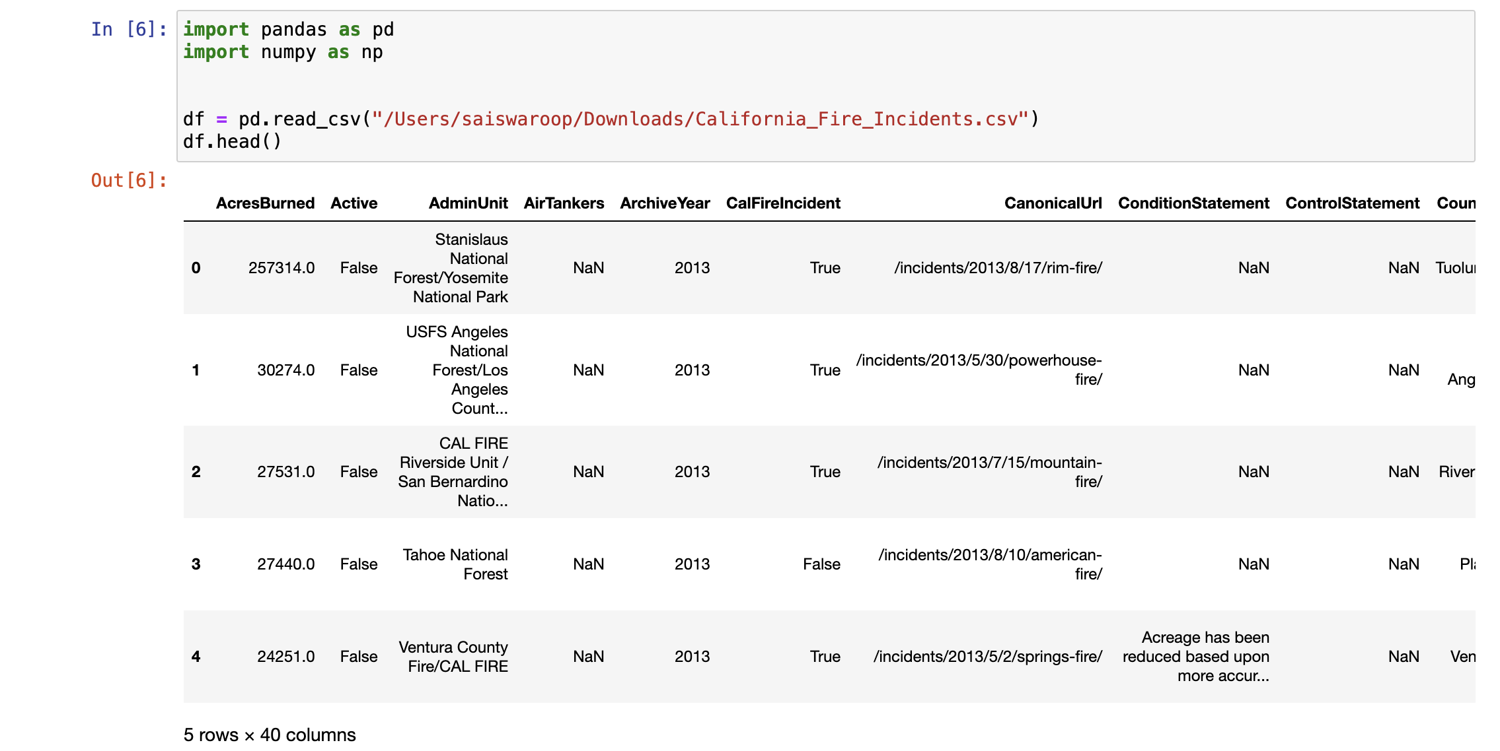
By analysing modifications in air quality metrics during wildfire events, we aim to provide practical advice to guide policymakers, firefighters, and area residents on reducing the health risks induced by air pollution produced during wildfire events.​

Slide 4
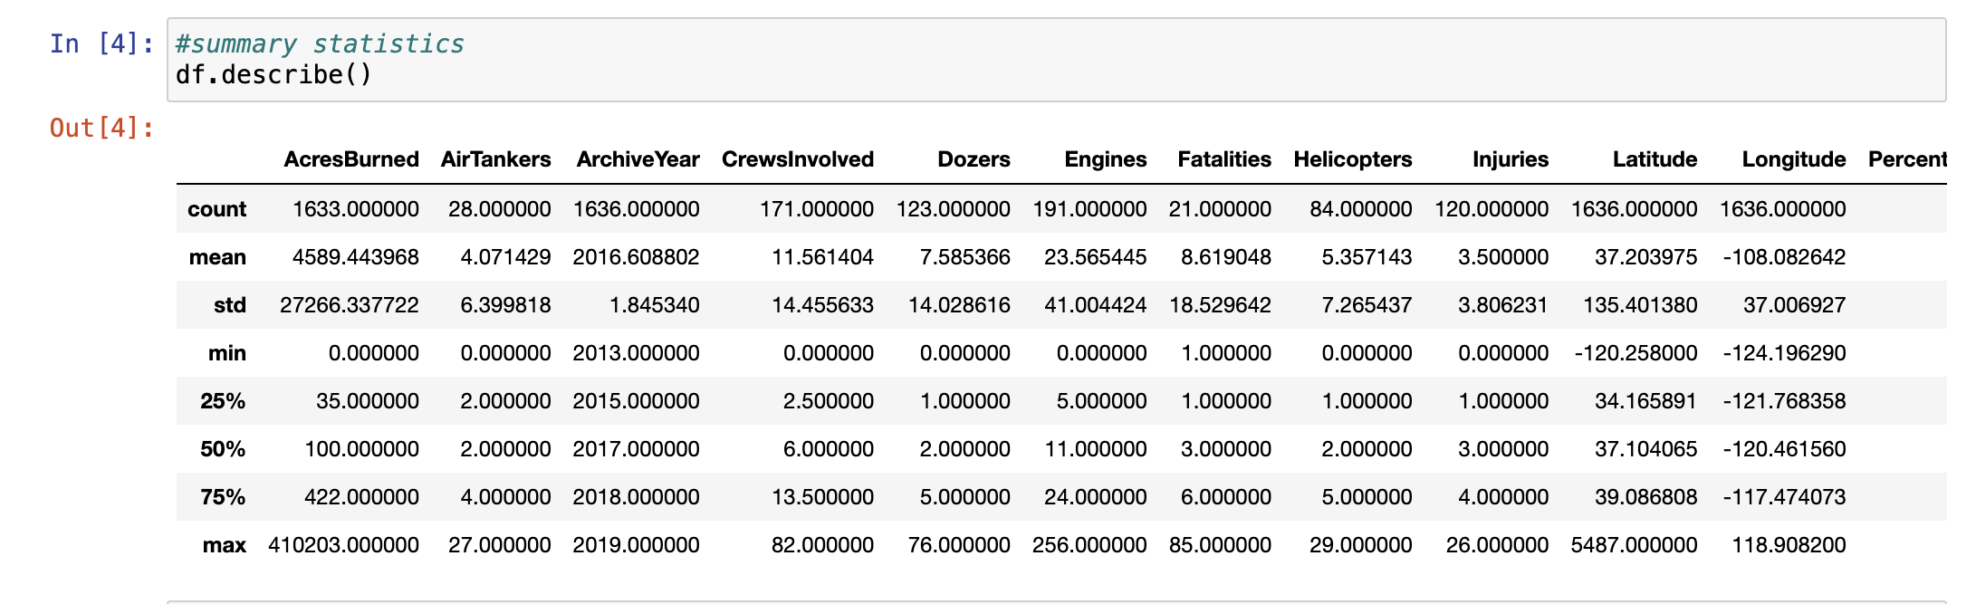
Our findings will help communities, policymakers, and stakeholders acquire the skills required for managing and responding to the growing problems of wildfires in California.
It will contribute to the ongoing conversation on climate change, environmental protection, and hurricane readiness. Join us in our mission to mitigate the devastating consequences of wildfires and ensure a safe and healthy environment for all

Slide 5
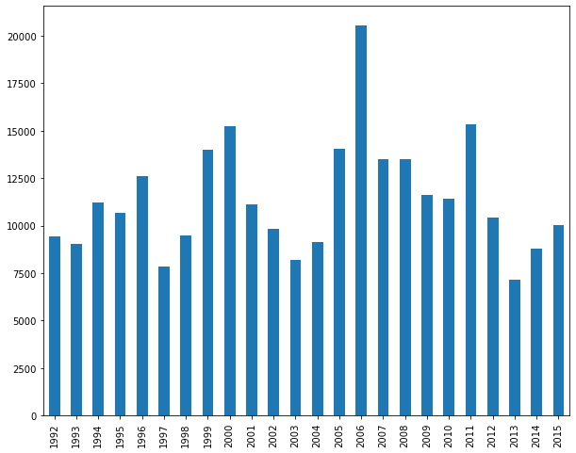
Data Exploration
This chart shows annual data from 1992 to 2015 with the vertical axis possibly representing a count or measurement related to wildfires. The heights of the bars fluctuate significantly over the years, with a notable peak around 2006, suggesting an increase in the measured variable during that year.

Slide 6
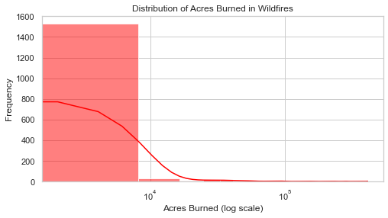
Histogram of `AcresBurned`:
This visualization showcases the distribution of the size of wildfires, highlighting the skewness towards smaller fires with a few significant outliers.
It helps understand the range and severity of wildfires, aiding in resource allocation and risk assessment.

Slide 7
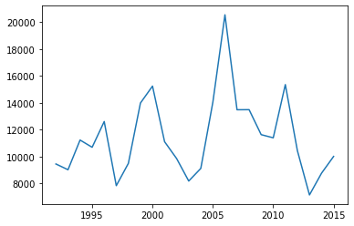
A time series line graph from 1995 to 2015 shows data points that peak sharply in 2005 and then decline. This could indicate the measurement of a specific factor related to wildfires, such as area burned or number of incidents, showing a significant event or change in 2005.

Slide 8
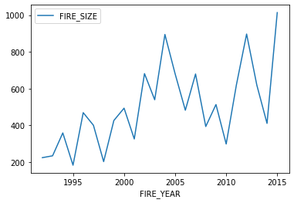
Another line chart, also spanning from 1995 to 2015, shows the variable labeled as "FIRE_SIZE." The graph has a somewhat erratic pattern with peaks and troughs, indicating fluctuations in the size of wildfires over the years.

Slide 9
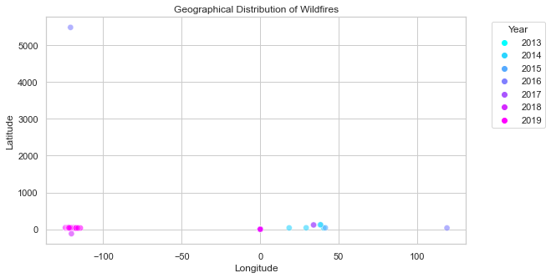
Geographical Distribution of Wildfires:
This scatter plot maps the latitude and longitude of wildfires from 2013 to 2019. Each point is color-coded by year, showing the locations of wildfires over these years. The concentration of points near the zero longitude line suggests most wildfires occurred in a specific region, possibly in a country or area centered around this longitude. The varying latitudes indicate that these fires spread across a wide vertical range.
Round Up makes it easy to see the number of wildfires burning in Utah. (39.320980, -51.093735) Landscape factors like steep mountains or dense forests can cause more frequent or larger wildfires.

Slide 10
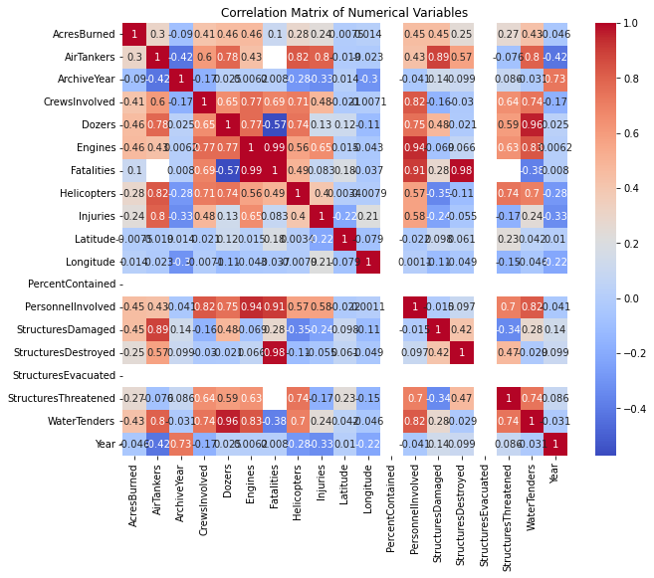
The matrix displays correlation coefficients between various variables related to wildfire management, such as Acres Burned, Crews Involved, Dozers, and Helicopters. Each cell in the matrix is color-coded, where blue represents a positive correlation and red indicates a negative correlation. Notable high correlations are between variables like Dozers and Engines, which could imply that when more dozers are used, more engines are also involved.

Slide 11
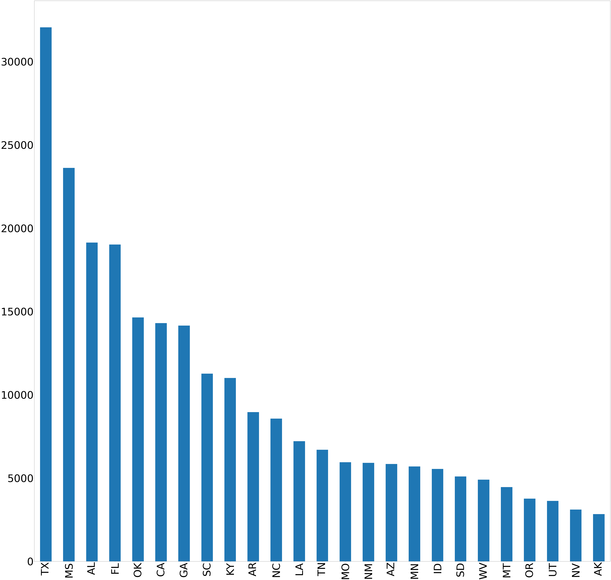
This chart compares data across U.S. states, labeled from TX to WY. It shows a descending order of values, with Texas having the highest and Wyoming the lowest. This could represent state-wise comparisons of wildfire incidents, areas burned, or resources used in wildfire management.

Slide 12
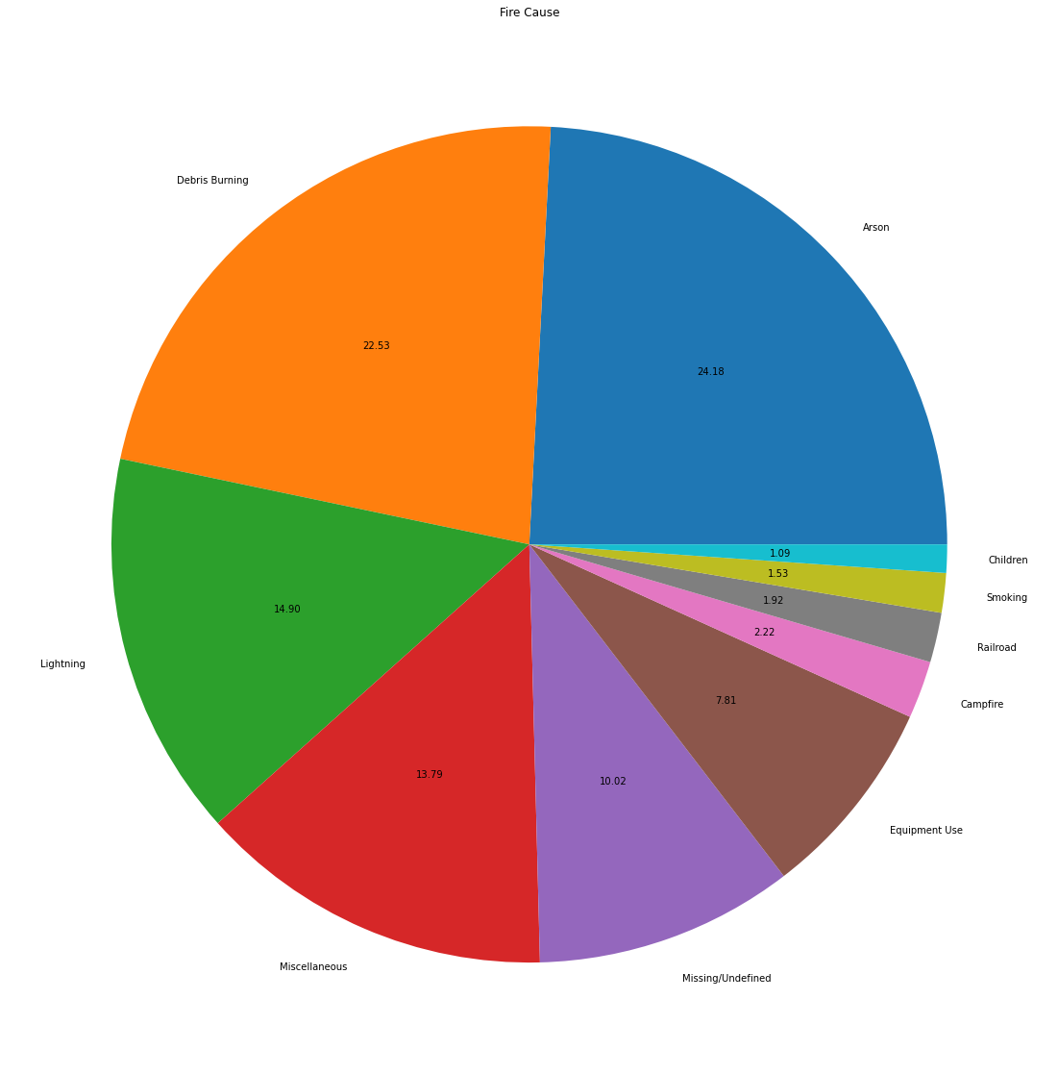
This chart presents the causes of wildfires, with each segment colored differently to represent various causes such as Debris Burning, Arson, and Lightning. Debris Burning is the largest segment, followed closely by Arson, suggesting these are the most frequent causes of wildfires.

Slide 13
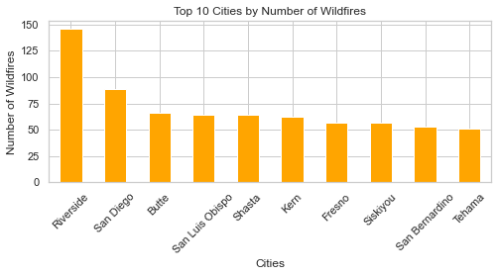
Number of WildFires (Top 10 Cities in California)
This bar chart ranks the top 10 cities by the number of wildfires reported. Riverside leads with the highest number of wildfires, followed by San Diego and Butte. The chart decreases in value as it moves to the right, showing fewer wildfires in cities like Fresno, Siskiyou, and Tehama. This visualization helps identify areas with higher wildfire occurrences, which can be crucial for resource allocation and preventive measures.

Slide 14
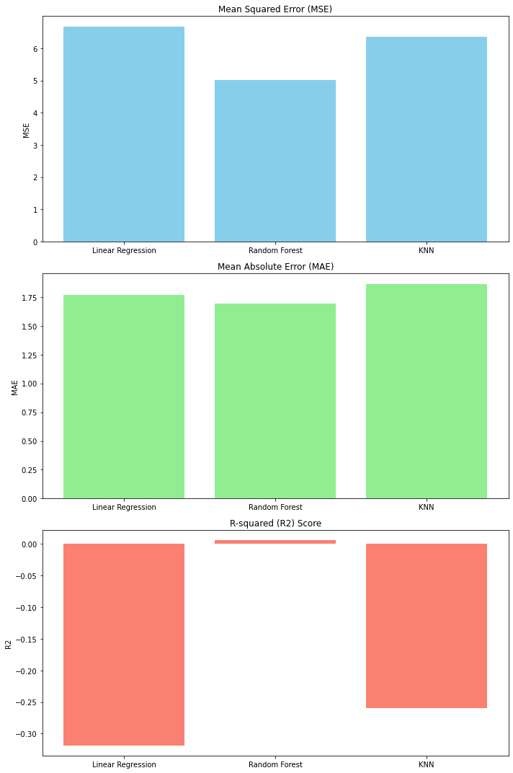
This collection of bar charts compares three machine learning models: Linear Regression, Random Forest, and k-Nearest Neighbors (KNN)
Across three different metrics: Mean Squared Error (MSE), Mean Absolute Error (MAE), and R-squared (R²) score.
MSE and MAE Charts: Lower values are better. The charts show that Random Forest and KNN perform similarly and better than Linear Regression in terms of MSE and MAE, indicating they might be more accurate or robust for the dataset used. - *R² Score Chart*: Higher values (closer to 1) are generally better. Negative values in the R² score chart for all models suggest that they do not fit the data well, indicating a possible need for model reevaluation or the use of more complex modeling techniques.

Slide 15
ML Models
Linear Regression: Predicts continuous variables related to wildfires based on linear relationships with predictors such as weather conditions or vegetation type. Effectiveness might be limited due to the complex and non-linear nature of wildfire behavior.
Random Forest Regressor: Uses multiple decision trees and is effective at handling various types of data and relationships. Potentially more robust for predicting complex phenomena like wildfires.
K-Nearest Neighbors Regressor (KNN): Predicts outcomes based on the proximity and characteristics of the nearest recorded data points. May not perform as well for complex patterns such as wildfires due to its reliance on local similarity.

Slide 16
Uses of ML in Wildfire Management
Prediction and Early Warning: ML models can predict the likelihood of a wildfire starting in a specific location based on factors like weather conditions, drought status, and human activity.
Behavior Modeling: During a wildfire, models can help predict how a fire will spread based on current weather conditions, the type of vegetation, and topographical features.
Post-Fire Analysis: After a wildfire, models can be used to analyze the effects and determine the factors that contributed most to the fire's spread and intensity. This analysis helps in planning and preparing for future fires.
Resource Management: Predictive models aid in the efficient distribution and deployment of firefighting resources and in planning evacuation routes and safety measures.

Slide 17
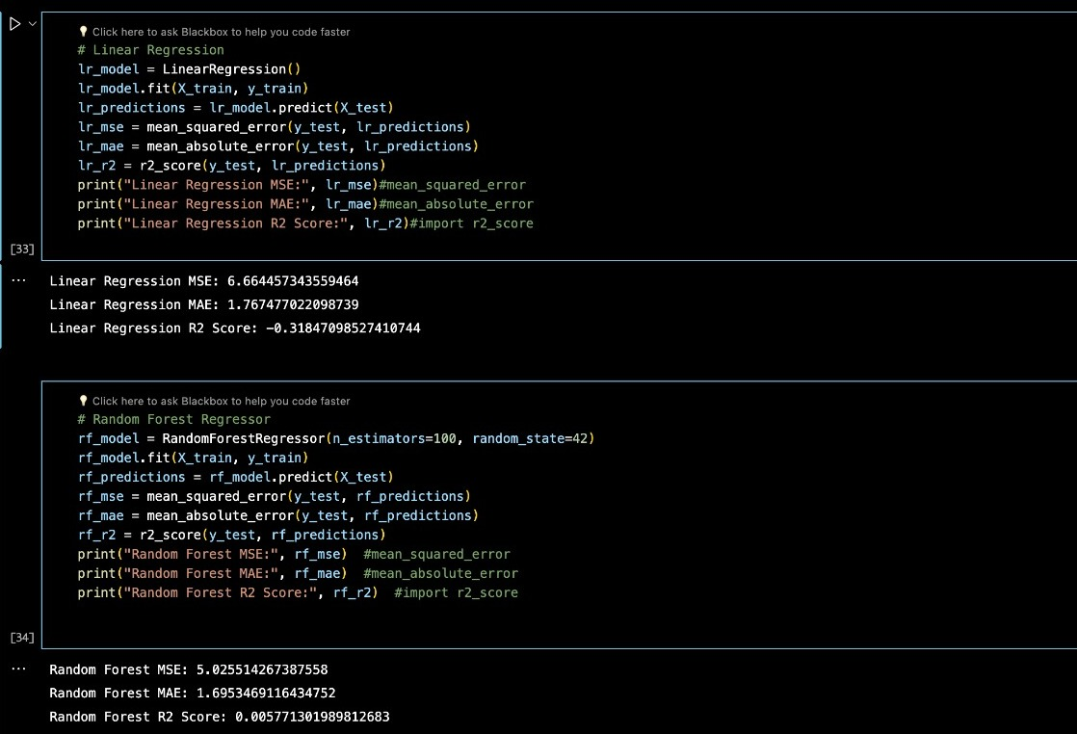
Linear Regression
Why Used: Linear regression is a fundamental analytical tool in statistical modeling and can provide quick predictions and insights into the linear relationships between variables.
Uses: - Estimating Burned Areas: It can help in predicting the area that might be affected by a fire, based on linearly related variables like temperature, humidity, and past fire data. Resource Allocation: By estimating the potential severity of a fire, resources such as firefighters and equipment can be allocated more effectively.

Slide 18
Random Forest Regressor
Why Used: Random Forest is robust against overfitting and can handle various data types and complex relationships between features. It is particularly useful when the relationship between input data and the target variable is non-linear and involves interactions among multiple input features.
Uses: Complex Prediction Tasks: Such as predicting the spread and behavior of wildfires under varying conditions.
Feature Importance Analysis: To identify the most significant predictors of wildfire characteristics, which can help in focusing preventive measures.

Slide 19
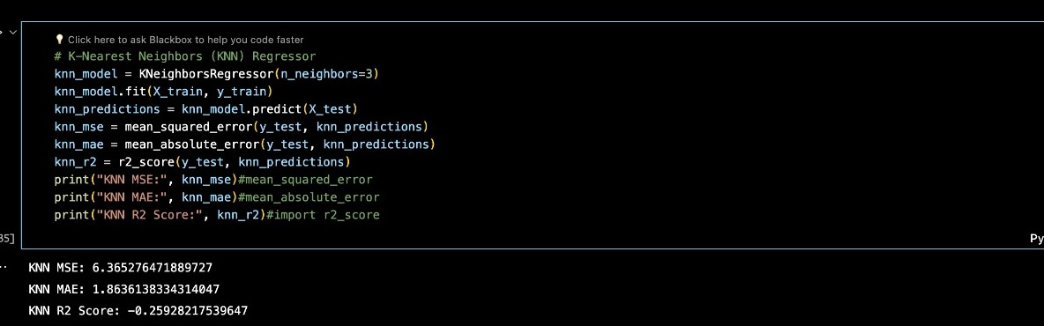
K-Nearest Neighbors (KNN)
Why Used: KNN is straightforward and can be highly effective if the right features are selected. It works on the principle that similar conditions lead to similar outcomes, which can be practical when historical data on wildfires is available and well-documented.
Uses: Predicting the Size of Wildfires: By analyzing the characteristics of past fires and their surroundings.
Assessing Risk Levels: In different areas based on geographical proximity to past events and similar environmental conditions.

Slide 20
General Uses of ML in Wildfire Management:
Prediction and Early Warning: ML models can predict the likelihood of a wildfire starting in a specific location based on factors like weather conditions, drought status, and human activity.
Behavior Modeling: During a wildfire, models can help predict how a fire will spread based on current weather conditions, the type of vegetation, and topographical features.
Post-Fire Analysis: After a wildfire, models can be used to analyze the effects and determine the factors that contributed most to the fire's spread and intensity. This analysis helps in planning and preparing for future fires.
Resource Management: Predictive models aid in the efficient distribution and deployment of firefighting resources and in planning evacuation routes and safety measures.

Slide 21
Feature manipulation
To assess the impact of wildfires on air quality using the "California Fire Incidents" dataset, feature manipulation is crucial.
The selected key features include `AcresBurned`, `ArchiveYear`, `Latitude`, `Longitude`, and `Started`. Additionally, new engineered features like `Duration`, `Season`, and `SizeCategory` are used to provide deeper insights into air quality changes during and after wildfires.
This approach aims to aid decision-making for public health and safety.

Slide 22
Preliminary Results
Wildfires of all sizes can impact air quality by releasing soot and toxins. Larger fires require more complex and extensive firefighting resources, with a moderate to strong correlation between wildfire size and the use of resources like dozers and engines.
To tackle larger wildfires, AirTankers, CrewsInvolved, and Helicopters are used jointly. Severe human impact is highlighted by a significant positive correlation between fatalities and injuries, emphasizing the need for intensive resources to manage extreme wildfire incidents.

Slide 23

Challenges and Next Steps
Our study aims to develop machine learning models to estimate the intensity of wildfire impact on air quality. We will address the challenge of obtaining key variables by implementing data filling methods and incorporating external sources of smoke air quality data.
Our goal is to provide reliable information to key participants for effective response and mitigation strategies against wildfires' impact on air quality and public health.

